Slide 1
Dishonest Academics
By: Krysana Maragh
Eng 363W
Emory University

Slide 2
Hypertext Analysis
A person’s character is a trait developed within the confinements of a school. Meaning, attitudes regarding academic dishonesty are ironically cultivated in the academic system. In a small scale context, I intend to investigate if the lessons learned through the hidden curriculum influence the actions of college students in terms of abiding by campus rules such as the honor code. If consequence were removed from the equation, would students behave differently? When do students find it acceptable to break the rules?

Slide 3
The Objective
I intend to investigate the mechanisms that regulate rules in our society, the role of the hidden-curriculum in molding students, and attitudes revolving around the standard Honor Code in order to better understand public opinion about academic dishonesty.

Slide 4
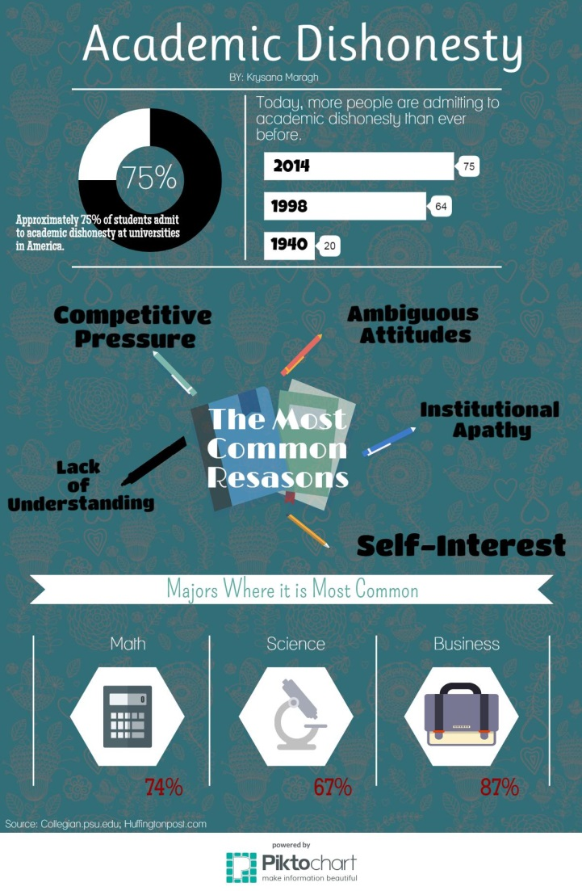
Infographic on the Issue
ABOUT 75 PERCENT OF COLLEGE STUDENTS ADMIT TO CHEATING, SUGGESTING THAT PROBABLY EVEN MORE THAN THREE QUARTERS OF COLLEGE STUDENTS HAVE DONE SOMETHING AGAINST THE RULES TO IMPROVE THEIR GRADES

Slide 5
The Research: The Hidden Curriculum
The one factor most students have in common prior to entering a college arena is we've all been exposed to a sort of hidden curriculum:
a side effect of the educational process that results in the indirect, not unintended, learning of
Particular values
Beliefs
Acceptable norms of a culture
Depending on societal pressures and expectations, certain aspects of the hidden-curriculum are more highly valued than others

Slide 6
The Research: The Hidden Curriculum
Some students, however, “play school” where they only appear to go along with the trends in order to gain advantage, such as
good grades
favoritism
but never actually internalize the values or views presented.

Slide 7
The Research: The Role of Rules
Starting with the basics, a rule is defined as a one of a set of either explicit or understood regulations or principles governing conduct within a sphere
A society is at its safest when all of its citizens adhere to the same rules. Hobbes theorized that by agreeing to live within a society, the citizen is thus agreeing to abide by its ruler and rules. This is the idea of the social contract
In many ways, the standard university Honor Code is a form of social contract

Slide 8
The Research: The Honor Code
Studies revealed that honor codes can be quite impactful and drastically affect rates of academic dishonesty by employing the use of Social Contract Theory
Students are responsible for policing each other. It is theorized that a person is more likely to “behave” when they are answerable to their peers as opposed to some hierarchical authority
But, there seems to be a divide between what students ought to do versus what is actually done.

Slide 9
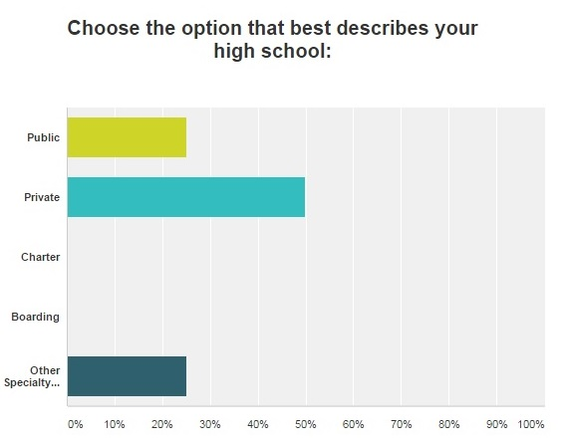
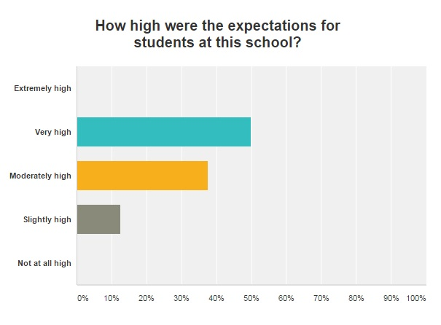
The Data
The majority of the participants completed their secondary education at private institutions
The majority of participants perceived their expectations for success at their secondary education to be "Very High".

Slide 10
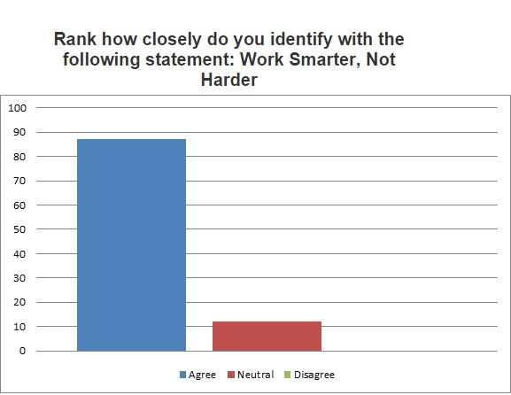
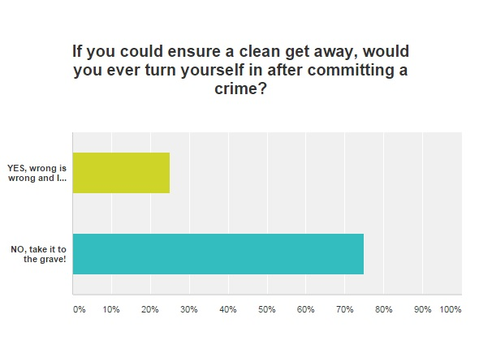
The Data
An overwhelming majority of participants agree with philosophy to Work Smarter, Not Harder
And when polled about the prospect of punishment for operating outside the bounds of the law, the majority of participants vowed to conceal their crimes.

Slide 11
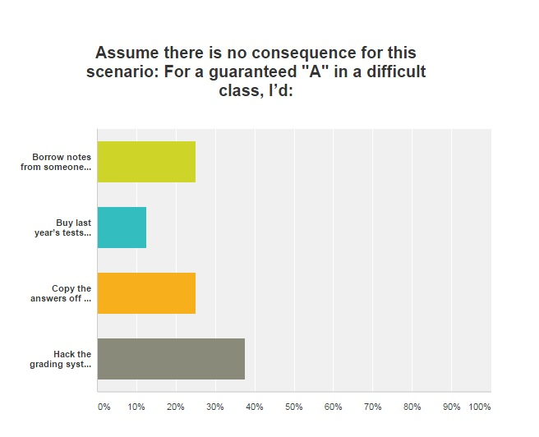
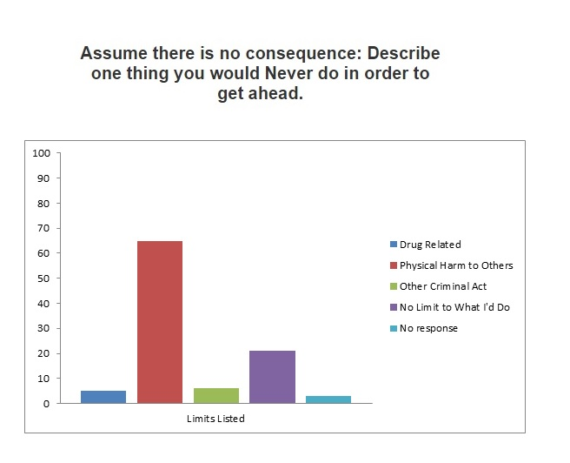
The Data
When presented with a consequence scenario, the majority of participants would opt to break the Honor code (the third and fourth options) in order to succeed.
70% of participants regarded there only limit in the pursuit of success would be physical harm to others

Slide 12
Conclusion
The results of this survey collectively suggests that students at this institution set their expectations high but would gladly take the easiest route presented to accomplish the same goals.
If fear of consequence were not a factor, the culture of this institution would be drastically different.
Students don't follow the rules because they agree with them, they do so purely out of self-preservation

Slide 13
Conclusion
I argue students believe it is acceptable to break the rules in pursuit of success.

Slide 14
Sources
Callahan, D. (2010, December 14). Why Honor Codes Reduce Student Cheating. Retrieved April 28, 2015, from http://www.huffingtonpost.com/david-callahan/why-honor- codes-reduce-st_b_795898.html
Eksi, H. (2012, January 1). The Effect of Hidden Curriculum on Character Education Process of Primary School Students. Retrieved March 28, 2015, from http://www.academia.edu/2313560/The_Effect_of_Hidden_cu rriculum_on_Character_Education_Process_of_Primary_Schoo l_Students
Mastin, L. (2008, January 1). Deontology - By Branch. Retrieved April 9, 2015, from http://www.philosophybasics.com/branch_deontology.html

